Slide 1




ML @ ICL
Episode 17
Deep learning whereabouts
A catch-all lecture in useless philosophy & practical tricks

Slide 2
Previously on deep learning...

Slide 3
Feature extraction
Feature
Extractor
(manual)
Classifier
Ɵ1~{W,b}
X
Prediction

Slide 4
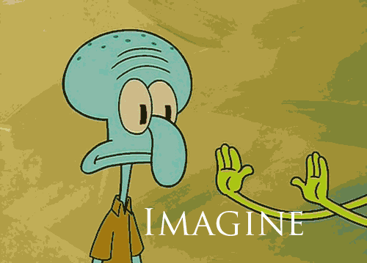
Features would tune to your problem automatically!

Slide 5
Simple neural network
Linear
model
σ(h)
Linear
model
σ(h)
X
Prediction
Trains with stochastic gradient descent!
or momentum/rmsprop/adam/...

Slide 6
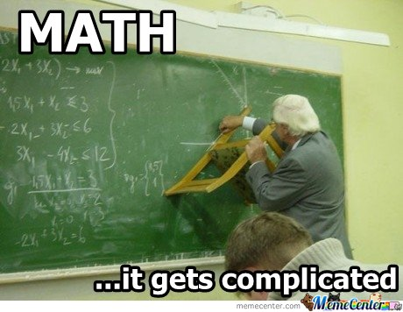
Backpropagation
TL;DR: backprop = chain rule*
* g and x can be vectors/vectors/tensors

Slide 7
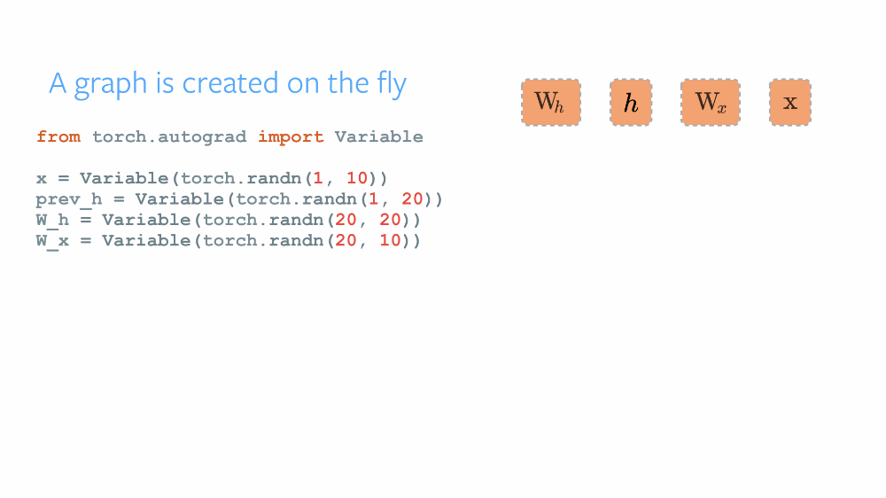
Dynamic graphs
Chainer, DyNet, Pytorch

Slide 8
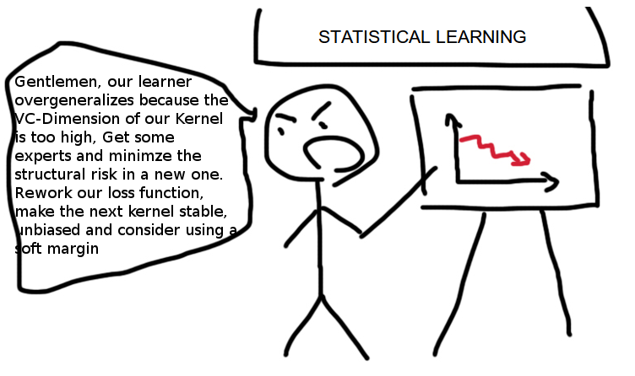
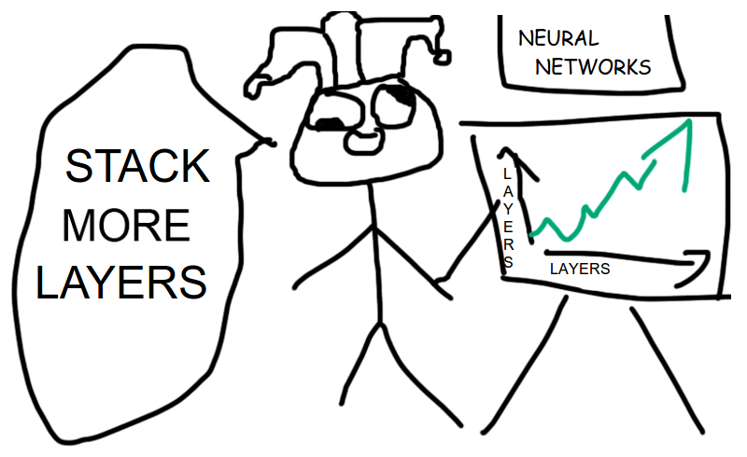
Not magic!
Don't expect deep learning to solve all your problems for free. For it won't.
vs
https://i.warosu.org/data/sci/img/0073/62/1435656449422.png

Slide 9
Not magic
Book of grudges
  No core theory
    Relies on intuitive reasoning

Slide 10
Not magic
Book of grudges
  No core theory
    Relies on intuitive reasoning
  Needs tons of data
    You need either large dataset or heavy wizardry

Slide 11
Not magic
Book of grudges
  No core theory
    Relies on intuitive reasoning
  Needs tons of data
    You need either large dataset or heavy wizardry
  Computationally heavy
    Running on mobiles/embedded is a challenge

Slide 12
Not magic
Book of grudges
  No core theory
    Relies on intuitive reasoning
  Needs tons of data
    You need either large dataset or heavy wizardry
  Computationally heavy
    Running on mobiles/embedded is a challenge
  Pathologically overhyped
    People expect of it to make wonders

Slide 13
Deep learning is a language

Slide 14
Deep learning is a language
in which you can hint your model
on what you want it to learn

Slide 15
Deep learning is a language
Say, you train classifier on two sets of features
Raw
features
Target
High-level
features

Slide 16
Deep learning is a language
Say, you train classifier on two sets of features
Raw
features
Car photo
(image pixels)
Target
Car
price
High-level
features
Car brand,
model, age,
blemishes

Slide 17
Deep learning is a language
Naive approach
Raw
features
Dense
256
Dense
256
Dense
256
Target
High-level
features

Slide 18
Deep learning is a language
Naive approach
Mixes raw
and hi-lv
Raw
features
Dense
256
Dense
256
Dense
256
Target
High-level
features

Slide 19
Deep learning is a language
Less naïve approach
Raw
features
Dense
256
Dense
256
Dense
256
Target
High-level
features

Slide 20
Deep learning is a language
Less naïve approach
Both inputs
are hi-lv
Raw
features
Dense
256
Dense
256
Dense
256
Target
High-level
features

Slide 21
Deep learning is a language
“Image features should be less important”
if that's what you want to say
Raw
features
Dense
256
Dense
32
Dense
256
Target
High-level
features
Dense
256

Slide 22
Deep learning is a language
You have a small dataset
Portrait
(pixels)
Dense
256
Dense
256
Dense
256
Style of
clothes
(5k samples)

Slide 23
Deep learning is a language
You have a small dataset
and a larger dataset with similar task
Portrait
Dense
256
Dense
256
Dense
256
Style of
clothes
(5k samples)
Age,
gender,
(1kk samples)

Slide 24
Deep learning is a language
You have a small dataset
and a larger dataset with similar task
Dense
256
Style of
clothes
(5k samples)
Portrait
Dense
256
Dense
256
Dense
256
Age,
gender,
(1kk samples)

Slide 25
Deep learning is a language
I want to learn features for style classification
that also help determine age & gender
Dense
256
Style of
clothes
(5k samples)
Portrait
Dense
256
Dense
256
Dense
256
Age,
gender,
(1kk samples)
Gradient flow

Slide 26
Deep learning is a language
For images:
  “I want to classify cats regardless where they are”
  “I don't want model to be indifferent to small shifts”
For texts:
  “Model should reconstruct the underlying process”
In general:
  “I don't want model to trust single feature too much”
  “I want my features to be sparse”

Slide 27
Let's see a few more “words”

Slide 28
Regularization
Neural networks overfit like nothing else.
Gotta regularize!
We can use L1/L2 like usual, but there's more!

Slide 29
Regularization
Dropout:
“I don't my network to trust
any single neuron too much”
Idea:
At training time, with probability p
multiply neurons by zero!
Scale up the remaining neurons to keep average the same

Slide 30
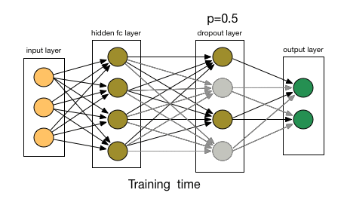
Regularization
Dropout:
“I don't my network to trust
any single neuron too much”

Slide 31
The problem with deep networks
Imagine a 100-layer network with ReLU
X
relu
relu
...
relu
relu
y
relu
relu
...
relu
relu

Slide 32
The problem with deep networks
Imagine a 100-layer network with ReLU
relu
0.9
relu
1.1
...
relu
0.6
relu
X
1.2
0.3
y
relu
relu
...
relu
relu

Slide 33
The problem with deep networks
Imagine a 100-layer network with ReLU
Single gradient step...
1.0
1.2
0.7
1.3
relu
0.9
relu
1.1
...
relu
0.6
relu
0.4
X
1.2
0.3
y
relu
relu
...
relu
relu

Slide 34
The problem with deep networks
Imagine a 100-layer network with ReLU
Single gradient step...
These guys explode
1.0
1.2
0.7
1.3
relu
0.9
relu
1.1
...
relu
0.6
relu
0.4
X
1.2
0.3
y
relu
relu
...
relu
relu

Slide 35
The problem with deep networks
Imagine a 100-layer network with ReLU
Single gradient step...
These guys explode
1.0
1.2
0.7
1.3
relu
0.9
relu
1.1
...
relu
0.6
relu
0.4
X
1.2
0.3
y
relu
relu
...
relu
relu
Those guys are broken
and need to re-adjust

Slide 36
The problem with deep networks
Imagine a 100-layer network with ReLU
Single gradient step...
These guys explode
1.0
1.2
0.7
1.3
relu
0.9
relu
1.1
...
relu
0.6
relu
0.4
X
1.2
0.3
y
relu
relu
...
relu
relu
N(0,1)
Those guys are broken
and need to re-adjust
not N(0,1)

Slide 37
Batch normalization
TL;DR:
  It's usually a good idea to normalize linear model inputs
      (c) Every machine learning lecturer, ever

Slide 38
Batch normalization
Idea:
  We normalize activation of a hidden layer
    (zero mean unit variance)
  Update with moving average while training

Slide 39
Batch normalization
Idea:
  We normalize activation of a hidden layer
    (zero mean unit variance)
  Update with moving average while training
i stands for i-th neuron

Slide 40

Batch normalization
Linear
model
σ(h)
Batch
norm
Linear
model
Batch
norm
σ(h)

Slide 41
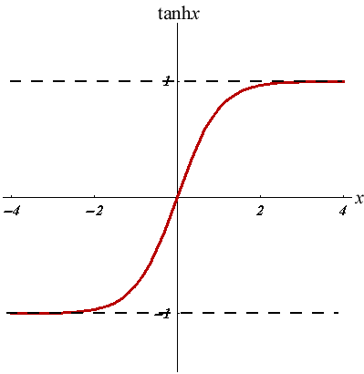
Batch normalization
Good side effect #1:
  Vanishing gradient less a problem for sigmoid-like nonlinearities
Good side effect #2:
  We no longer need to train bias (+b term in Wx+b)

Slide 42
Weight normalization
Same problem, different solution
  Learn separate “direction” w and “length” l
  Much simpler, but requires good init

Slide 43
More normalization
Layer/Instance normalization
  Like batchnorm, but normalizes over different axes
Normprop
  A special training algorithm
Self-normalizing neural networks (SELU)

Slide 44
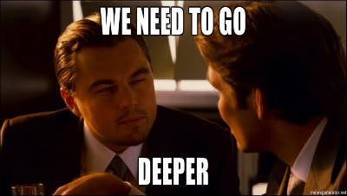
Nuff
Coding time!

